Slide 1
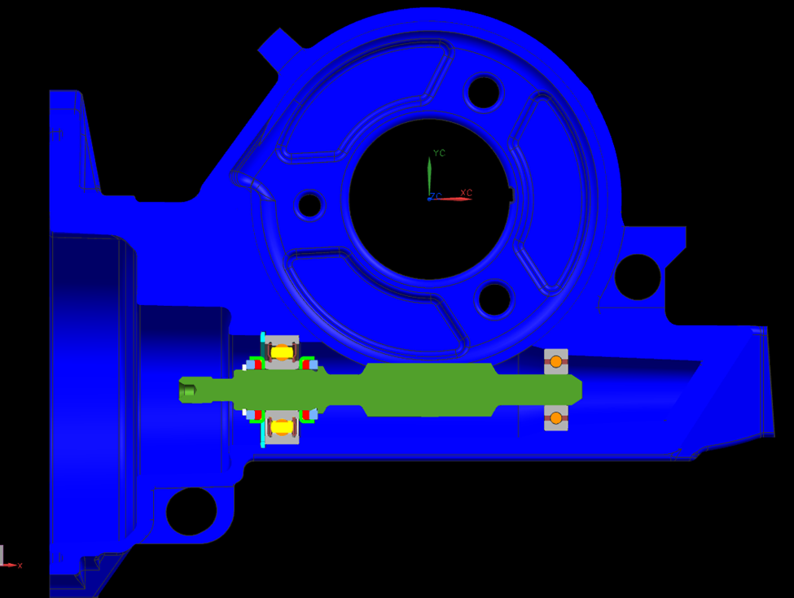
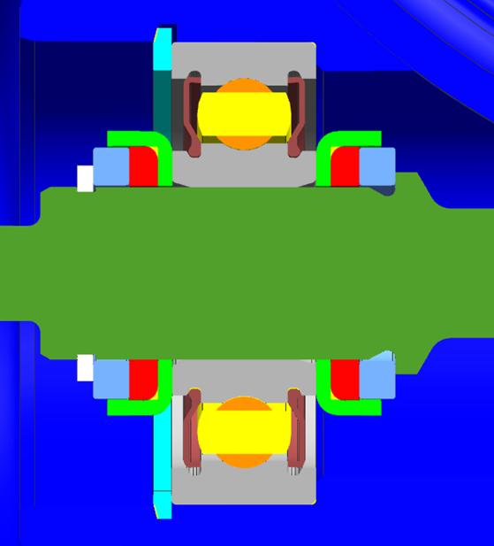
CCM-129: Stiffer Assist Path for Worm Shaft
Last updated: 03JN15
Description
Develop single isolated bearing worm axis design
Motivation : 14.0
Deliverables
Provide prototype systems for development testing
Obtain components for more builds
Development testing
Timing
Development test systems ASAP
Team Members/Customers
Team names: Brad Sundholm / Josh Mullins
Customers: Stan Schlatter / Don Smith / Steve Klein

Slide 2
CCM-129: Stiffer Assist Path for Worm Shaft
Last updated: 03JN15
Status Update:
Latest Design on Assist Mech Bottoming
Part stopped at 1.5 lives
Sleeve moved within housing
Parts tracker created for future builds
Worm axis bearing configuration
Test several different iterations
Offset bearing bores
Single row vs four point
Threaded plug vs snap ring
Cost Request In Process (SPEPS)
CR #3000969
CEPS Testing (Gamma T300)
In vehicle testing in silver Sonic
Need to create print for modified assist housings
Challenges:
Assist housing procurement
Pressed plug retention
Determining best configuration for worm axis bearings
Next Actions:
Obtain new assist housings (Sundholm)
Create print for CEPS system (Sundholm)
FDR testing (Mullins)
Impact testing (Sundholm)

